Slide 1


The 3rd International Conference on Intelligent Systems and Data Science (ISDS 2025)
Breast Cancer Classification Using Ensemble Deep Learning with RIDOPT-Net
Ho-Dat TRAN, Thuong-Cang PHAN,
Van-Kha VO, Anh-Cang PHAN
CanTho, Nov-19-2025
Notes:
Good morning everyone, I’m very please present my research , Breast cancer classification based on fuzzy rules and deep learning techniques

Slide 2
CONTENT
1. Introduction
2. Related works
3. Proposed method
5. Conclusion
4. Experimental results
Notes:
The following is the content for my presentation. Section 2 introduces and summarizes related work. In Sections 3, we provide a detailed description of the main components of our approach. We describe the experimental setup to validate our approach along with a discussion of the results in Section 4. Finally, we conclude with a summary of our findings and comment on possible future directions in Section 5.

Slide 3

1. Introduction
Challenges
Breast cancer is one of the most common cancers affecting women worldwide.
Early detection and accurate staging of breast cancer can significantly improve survival rates and quality of life for patients.
Fig 1. Images on 2 views a) RMLO b) LMLO c) RCC d) LCC with the mass location localized in images a) and c)
Notes:
As we know, cancer is one of the most common diseases in the world and takes the lives of millions of people every year. Breast cancer is one of the most common cancers affecting women worldwide.
Early detection and accurate staging of breast cancer can significantly improve survival rates and quality of life for patients..Figure 1 is an image of a breast with a mass of unusual brightness.

Slide 4
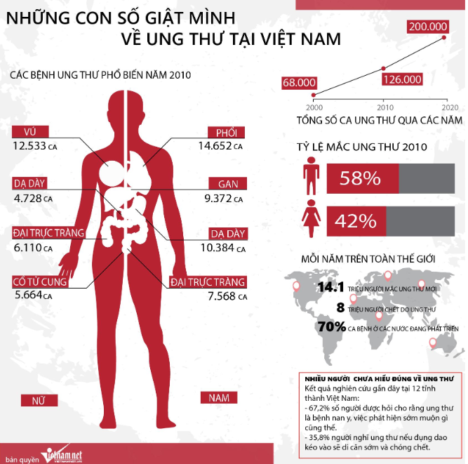
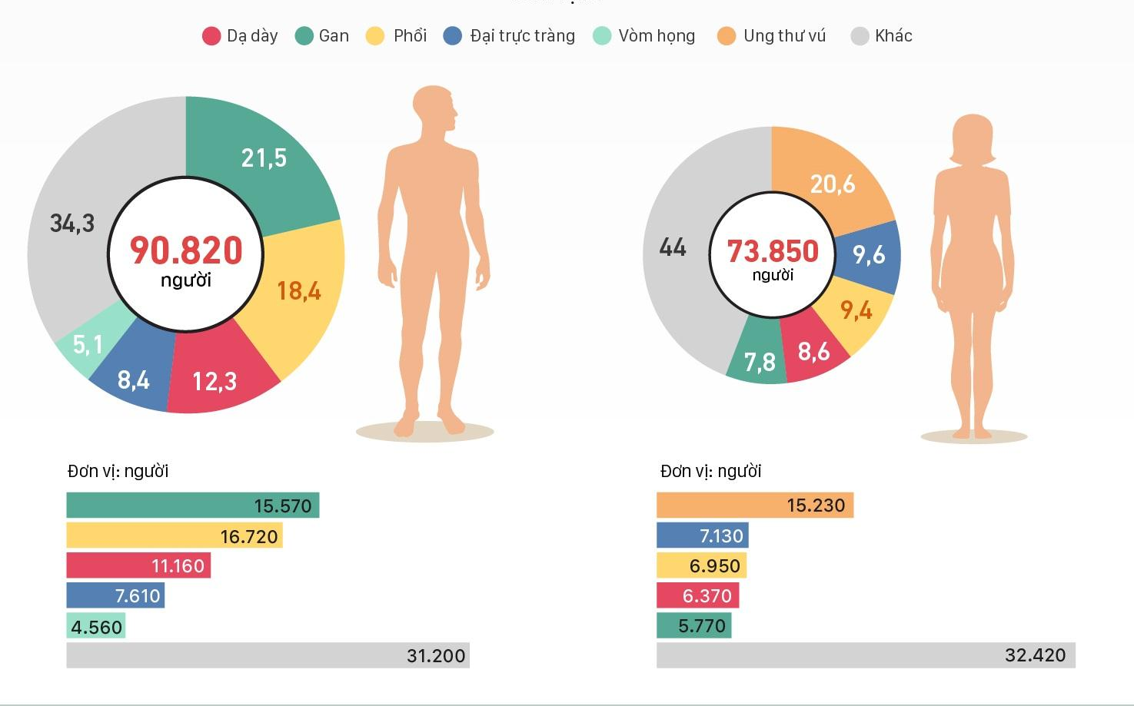
1. Introduction
Challenges
Breast cancer (BC) predicted has affected 2.3 million women worldwide in 2020, with 685,000 fatalities. Breast cancer had been detected in 7.8 million females in the previous five years as of 2020, making it the most common cancer on the planet. It causes more disability adjusted life years (DALYs) in women worldwidethan any other form of cancer[1].
Fig 2. Cancer statistics in Vietnam[15]
Notes:
According to GLOBOCAN statistics in 2020, the world is estimated to have about 19.3 million cases and 10 million deaths caused by cancer. Of which, breast cancer in women is 2.26 million cases, accounting for 11.7%.
In Vietnam, breast cancer is the leading disease among women. Because of the prevalence of this disease, there are currently many related studies being conducted with the goal of detecting and classifying breast cancer using many different methods, the most popular of which is the application of information technology in detecting and classifying abnormalities on mammograms.
Because of its popularity, there have been many research projects related to this disease in recent times.
Theo số liệu thống kê của GLOBOCAN trong năm 2020 cả thế giới ước tính có khoảng 19.3 triệu ca mắc và 10 triệu ca tử vong do ung thư gây nên. Trong đó, ung thư vú ở phụ nữ là 2.26 triệu ca chiếm 11.7%.
Tại Việt Nam ung thư vú là căn bệnh chiếm tỉ lệ hàng đầu đối với nữ giới. Chính vì mức độ phổ biến của căn bệnh này mà hiện nay có rất nhiều nghiên cứu có liên quan được thực hiện với mục tiêu phát hiện và phân loại ung thư vú bằng nhiều phương pháp khác nhau, trong đó phổ biến nhất là ứng dụng công nghệ thông tin trong phát hiện và phân loại các bất thường trên nhũ ảnh.

Slide 5



1. Introduction
Targets:
Detection and classification on mammograms based on deep learning techniques
Install and experiment with the model, test, evaluate and compare the results.
Optimizing weights of ensemble model to reduce the classification error rate
Notes:
Some of the key points our research covers are:
To achieve the above content, we briefly reviewed the research works of previous authors.

Slide 6
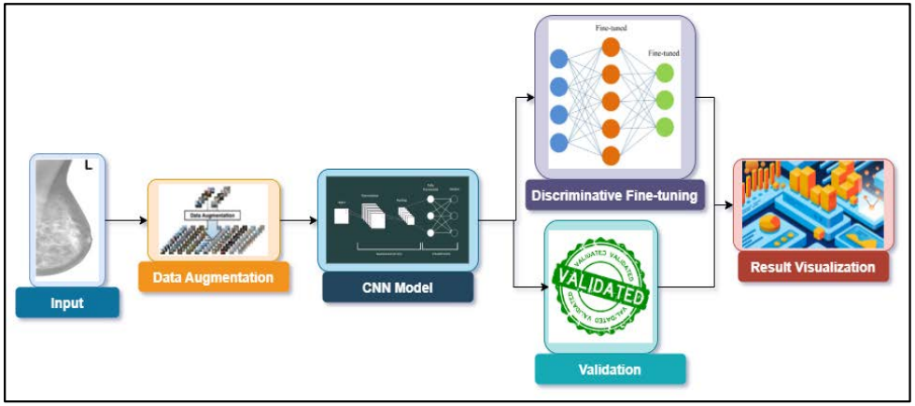
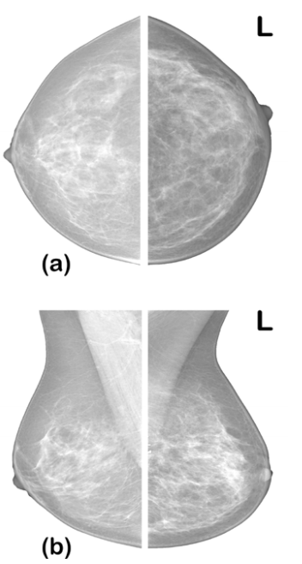
2. Related works
- Architecture network: AlexNet, VGG, SquezzeNet, ResNet, DenseNet
- Dataset: CBIS-DDSM
- Accuracy: 99.8%
Fig 3. Performance Evaluation of Deep Learning Models on Mammogram Classification Using Small Dataset [3]
Notes:
Adedigba và cộng sự y một phương pháp huấn luyện mô hình học sâu để chẩn đoán BC. Chúng tôi đã phát triển một phương pháp tinh chỉnh phân biệt, fine-tuning cho mỗi lớp của CNN sâu. Ngoài ra, mô hình được huấn luyện bằng phương pháp huấn luyện độ chính xác hỗn hợp để giảm bớt nhu cầu tính toán khi huấn luyện các mô hình học sâu. Cuối cùng, chúng tôi trình bày các phương pháp tăng cường dữ liệu cho chụp nhũ ảnh.

Slide 7
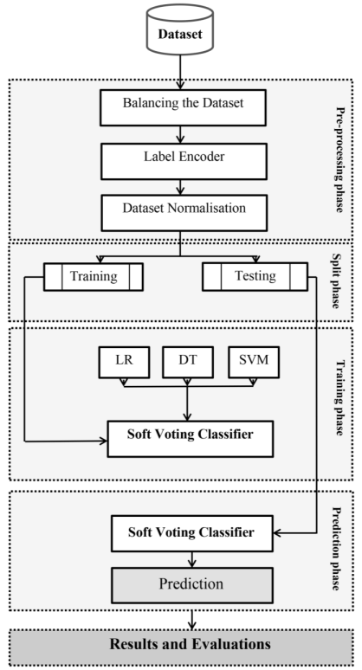
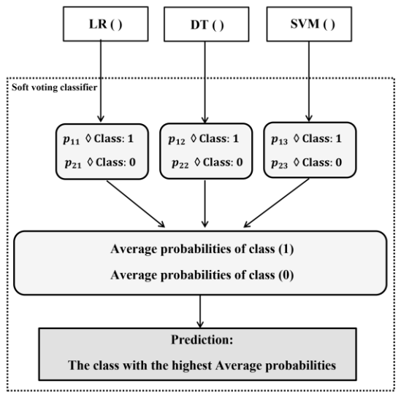
2. Related works
- Ensemble method: Decision Tree, Logistic Regression and Support Vector Machine
- Dataset: WDBC
- Accuracy: 98.25% (Hard voting)
Fig 4. Breast Cancer Prediction Using Soft Voting Classifier Based on Machine Learning Models [4]
Notes:
Breast Cancer Prediction Using Soft Voting Classifier Based on Machine Learning Models (Mohammed S. Hashim)

Slide 8
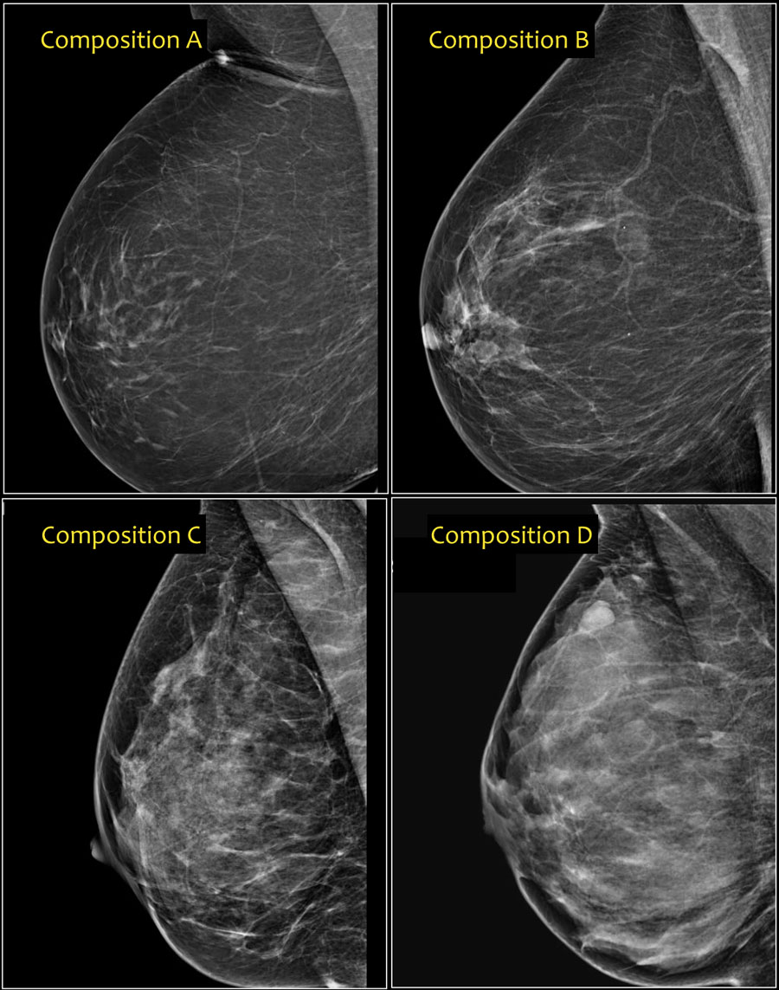
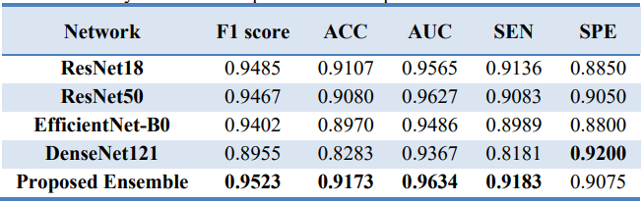
2. Related works
- Mammographic density classification (A, B, C, D) using a combined model (ResNet18, ResNet50, EfficientNet-B0, DenseNet121)
- Dataset: VinDr-Mammo
- Accuracy: AUC: 0.963, F1-score: 0.952 (Soft voting)
Fig 5. Attention-Enhanced Deep Learning Ensemble for Breast Density Classification in Mammography
Notes:
Attention-Enhanced Deep Learning Ensemble for Breast Density Classification in Mammography - Peyman Sharifian

Slide 9
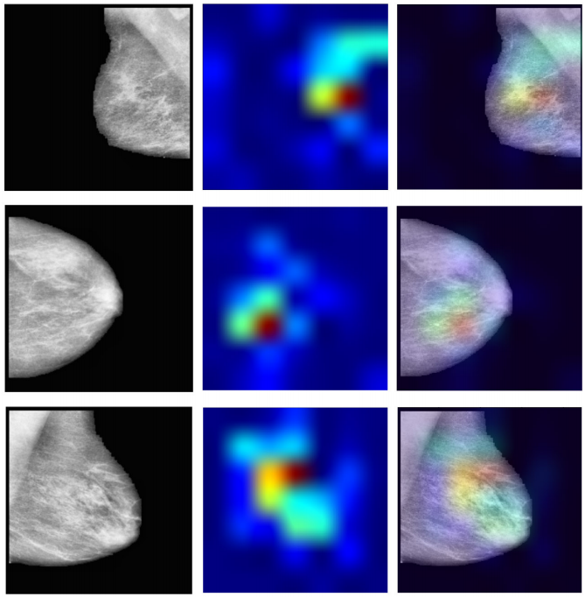
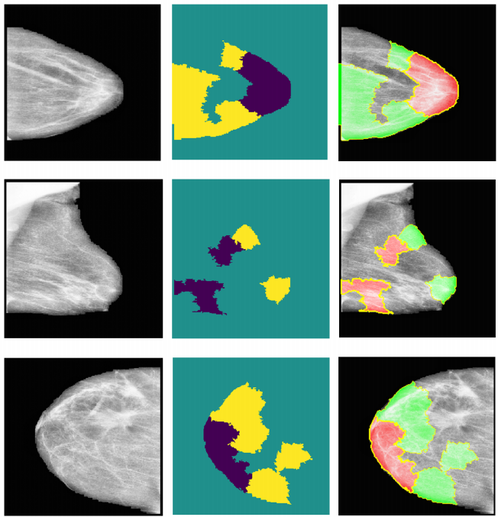
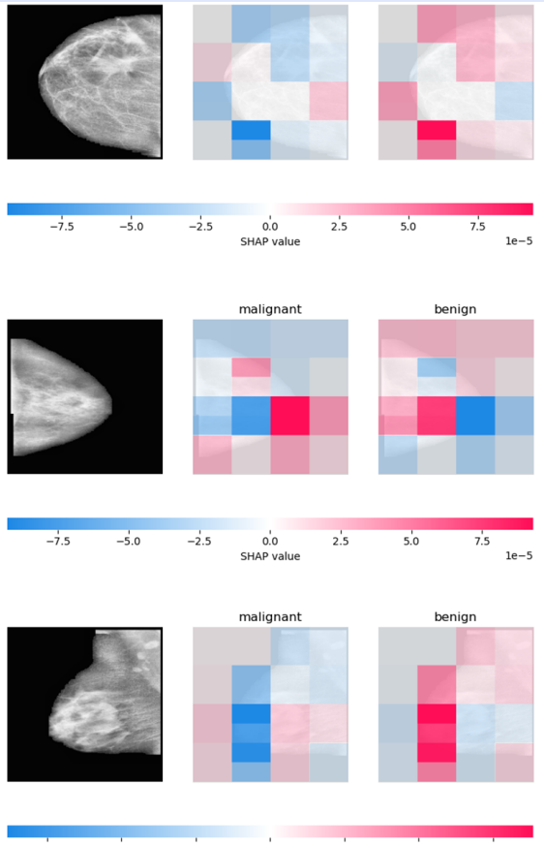
2. Related works
Model: VGG16, InceptionV3, Res-Net18
Dataset: CIBS-DDSM
Accuracy: 76%
Fig 6. Enhancing Breast Cancer Diagnosis in Mammography: Evaluation and Integration of Convolutional Neural Networks and Explainable AI (Ahmed et al. 2024)
Notes:
A focal point of our study is the evaluation of XAI’s effectiveness in
interpreting model predictions, highlighted by utilising the Hausdorff measure to assess the align-ment between AI-generated explanations and expert annotations quantitatively.

Slide 10
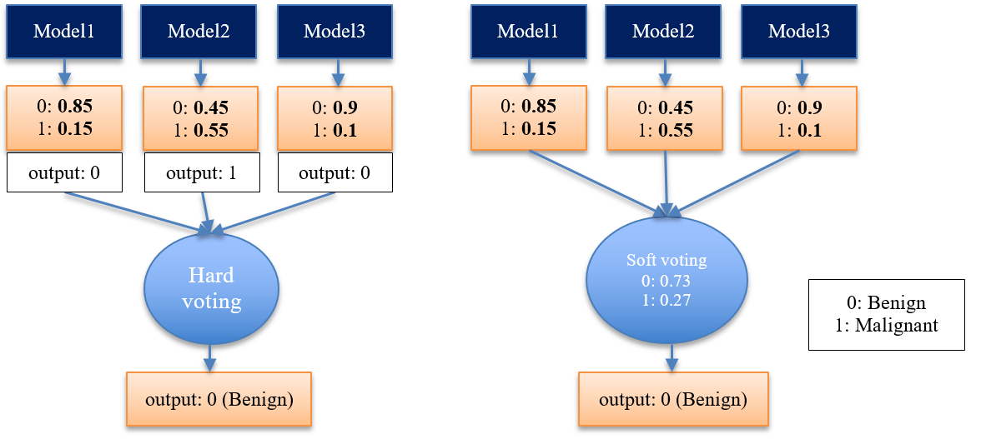
2. Related works
Hard/soft voting:
Fig 7. Illustration of Hard voting and Soft voting
Notes:
Hard Voting is based on majority rule. Each base model in the ensemble will give a final predicted label (e.g. Benign or Malignant). The final output of the ensemble is the label that appears most frequently among the models.
Soft Voting is based on a weighted average of the predicted probabilities. Instead of taking the label directly, the ensemble uses the predicted probabilities of each model

Slide 11
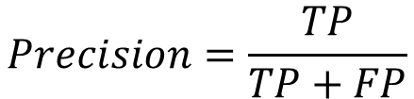
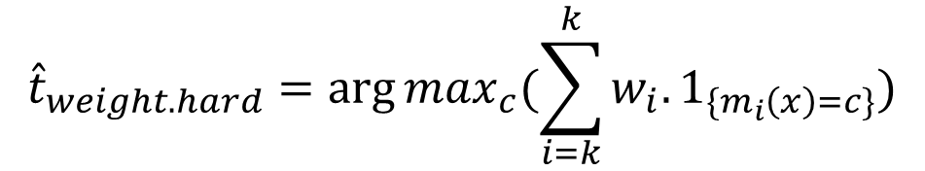
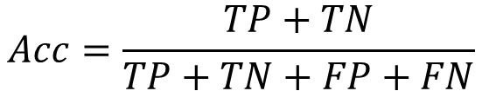

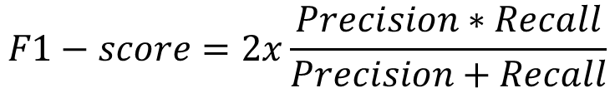
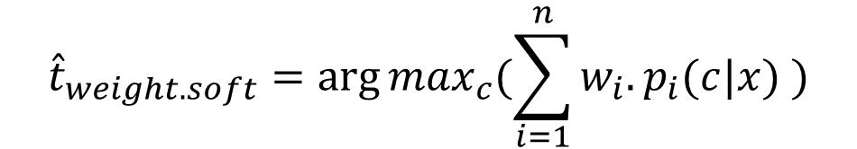




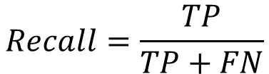
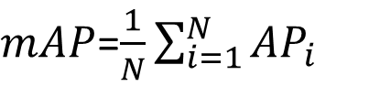


2. Related works
Evaluation metrics:
$${\hat{t}}_{weight.hard}=\arg{\max_{c}(\sum_{i=k}^{k}{w_{i}.1_{\{m_{i}\left(x\right)=c\}}})}$$
$$Acc=\frac{TP+TN}{TP+TN+FP+FN}$$
$$(1)$$
$$(2)$$
$${\hat{t}}_{weight.soft}=\arg{\max_{c}(\sum_{i=1}^{n}{w_{i}.p_{i}(c|x) })}$$
$$Precision=\frac{TP}{TP+FP}$$
$$(4)$$
$$(3)$$
$mAP$=$\frac{1}{N}\sum_{i=1}^{N}{{AP}_{i}}$
$$F1−score=2x\frac{Precision∗Recall}{Precision+Recall}$$
$$(5)$$
$$(6)$$
$$Recall=\frac{TP}{TP+FN}$$
$$(7)$$
Notes:
Some metrics we use in evaluating proposed models
where u_{i} is the ground truth at pixel 𝑖, $\hat{u_{i}}$ is the predicted value at pixel 𝑖 out of total number of pixels n.
In which, wi: weight of the ith model; 1{mi(x)=c} : equal to 1 if model i chooses
class c, otherwise equal to 0.

Slide 12
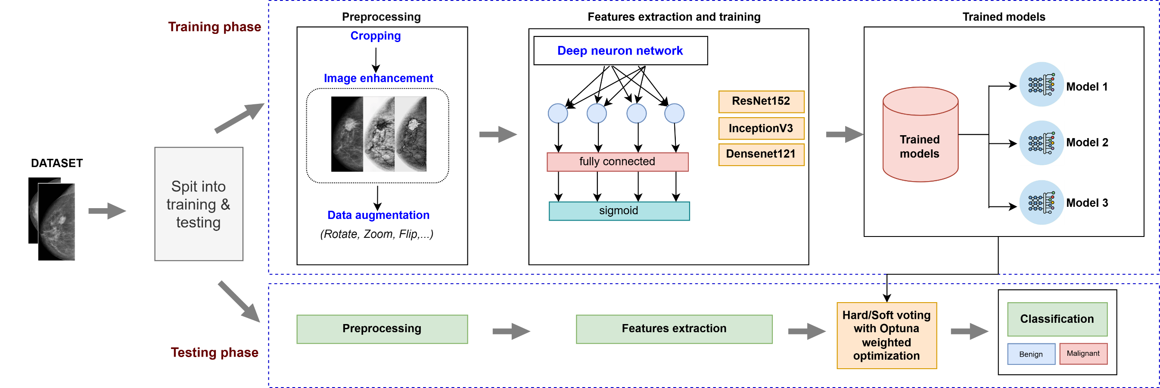
3. Proposed Method
Fig 8. A general model is proposed for breast cancer classification using RIDOPT-Net

Slide 13
3. Proposed Method
- Data preprocessing: the input data is preprocessed using a number of techniques such as cropping, image enhancement, and data augmentation (flip, rotate, zoom, etc.).
- Training phase: Each model is trained independently on the same dataset and unified parameters. We use the early stopping technique during training to limit the model from overfitting. The best training results of each model are saved for testing.
- Testing phase: The test image is processed similarly through data preprocessing steps, feature extraction, then hard voting and soft voting techniques are applied, combined with weights optimized by Optuna technique on 3 models, to give the final result as benign or malignant.

Slide 14
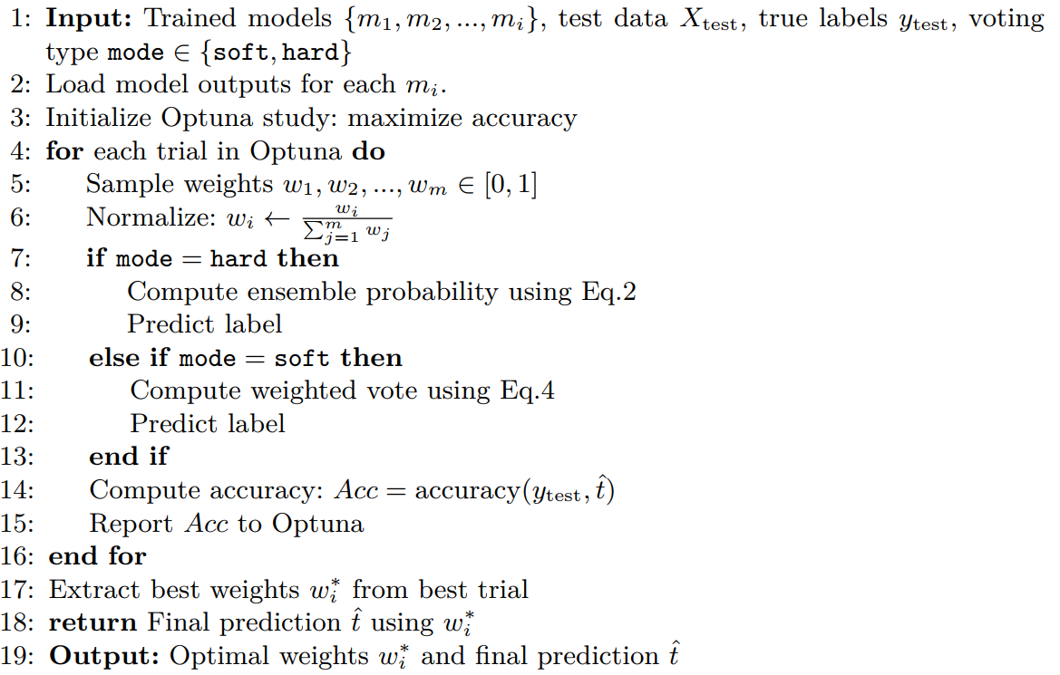
3. Proposed Method
RIDOPT-Net algorithm
Notes:
For each trial, Optuna:Generate new weights
Ensemble results of deep learning models
Calculate loss/accuracy
Save results
Adjust search direction

Slide 15
4. Experimental results
Environment: The system runs in a Python environment on Kaggle, using an Intel Xeon 2.00 GHz processor with 30GB RAM. It also utilizes a graphics processor with a 16GB RAM configuration and the Nvidia Tesla P100 GPU. Tensorflow v1.5 is the library used for network model training.
Dataset: The dataset is compiled from the VinDr dataset, supplemented with data from several hospitals. The number of images we use in the paper includes 6940 images (5862 images were used for training and 1078 images for testing). The dataset is divided in the ratio of 80:20.
Table 1: Proposed scenarios and training parameters
Sce. | Model | Epochs | Batch size | Learning rate | Optimizer
1 | InceptionV3 | 100 | 32 | 0.0001 | Adam
2 | ResNet152 | 100 | 32 | 0.0001 | Adam
3 | DenseNet121 | 100 | 32 | 0.0001 | Adam
4 | Ensemble Deep Learning (Hard voting)
5 | Ensemble Deep Learning (Soft voting)
6 | RIDOPT-Net (Hard voting)
7 | RIDOPT-Net (Soft voting)
Notes:
This dataset is divided into a training dataset and a validation dataset with a ratio of 80% and 20%, respectively. For testing, we build a hypothetical scenario where the students were doing the exam, then recorded a video, and tested it with a number of 15 videos on a cheating action to check the accuracy of the network models.
Table 1 presents the scenarios we used with the training parameters
In scenarios 2,3,5,6 we use algorithms to generate rule sets from the data extracted from the network models. The goal of this process is to improve the accuracy of the model by better handling ambiguous or contradictory cases in the data set. After conducting experiments with various sets of parameters, we selected identical parameters for all scenarios. The learning rate is set at 0.0001, with the training being conducted 100 times. The number of classes (Num classes) being 3, corresponding to benign, malignant and normal.

Slide 16
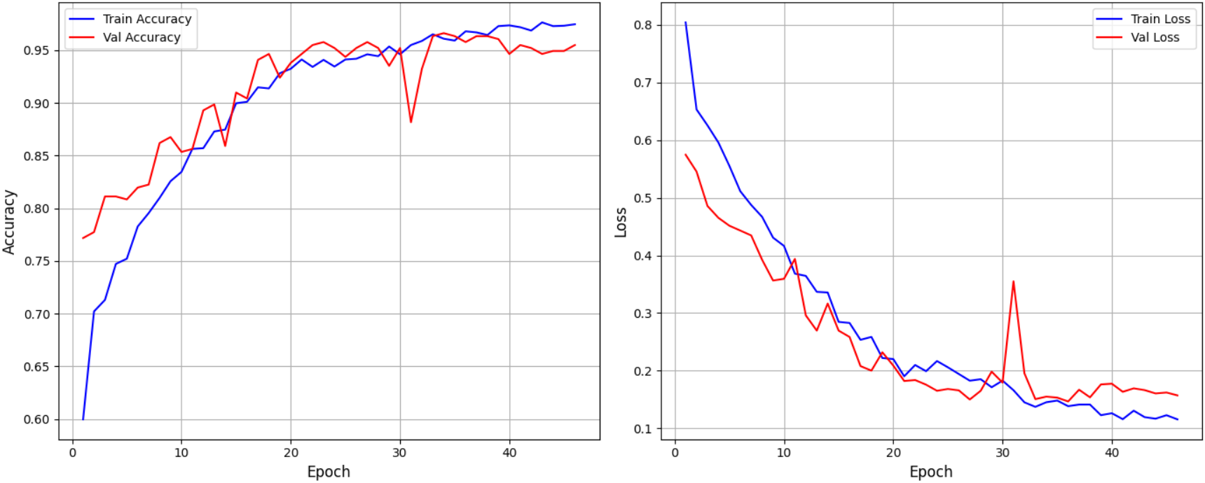
4. Experimental results
Training results
Fig 9a. The chart compares the accuracy and loss of Sce.1.

Slide 17
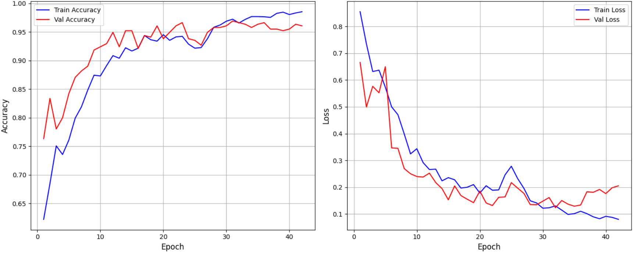
4. Experimental results
Training results
Fig 9b. The chart compares the accuracy and loss of Sce.2.

Slide 18
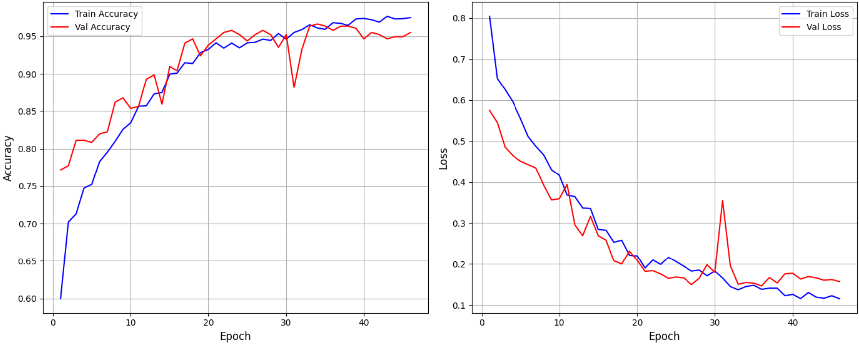
4. Experimental results
Training results
Fig 9c. The chart compares the accuracy and loss of Sce.3.

Slide 19
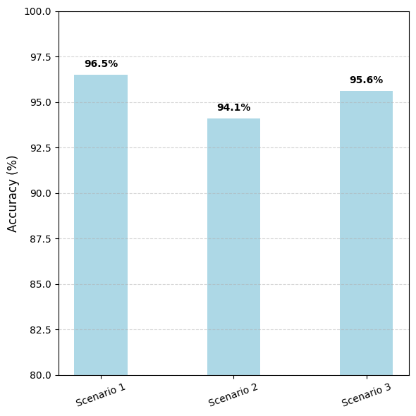
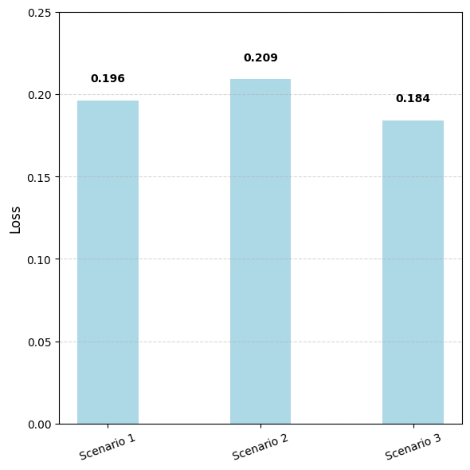
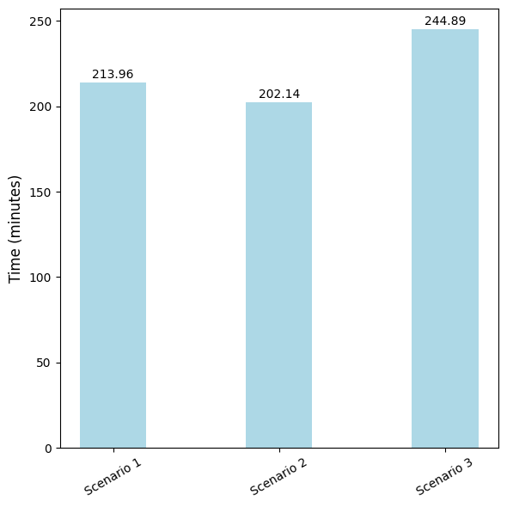
4. Experimental results
Training results

Slide 20
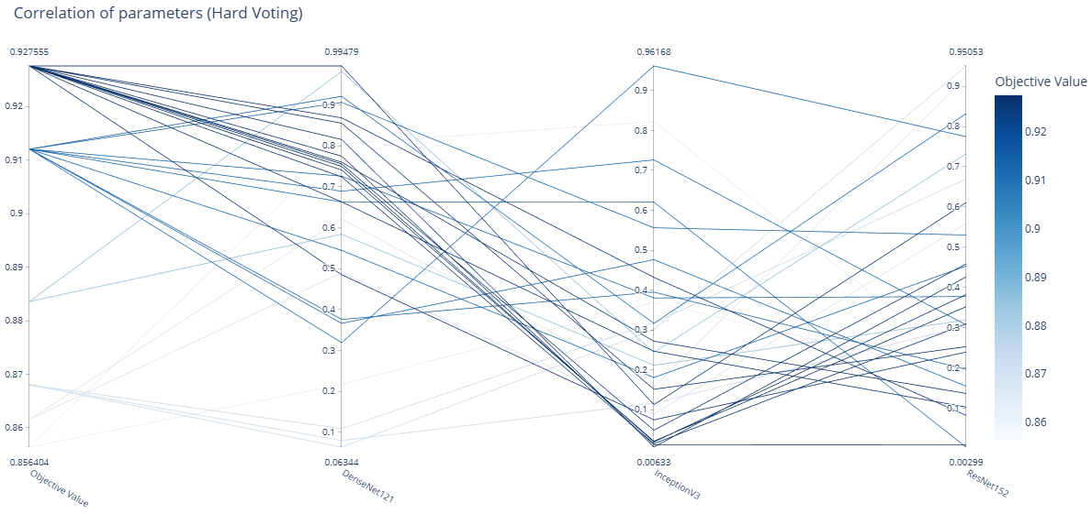
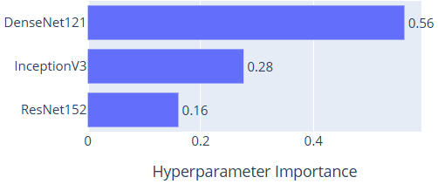
4. Experimental results
Fig 10a. Correlation and importance of parameters in Sce. 6.
Notes:
The colors of the lines represent the quality of each weight combination — darker lines correspond to higher objective values. The results show that the best objective values are often associated with high weights for DenseNet121, while InceptionV3 and ResNet152 often have lower weights.

Slide 21
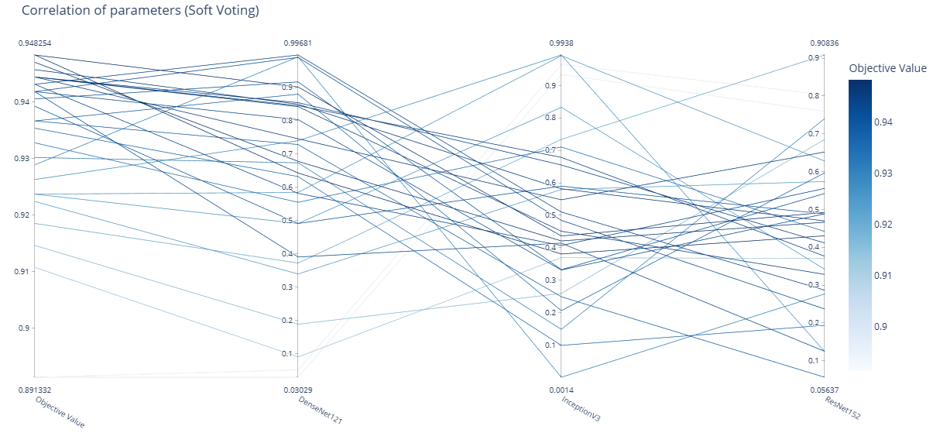
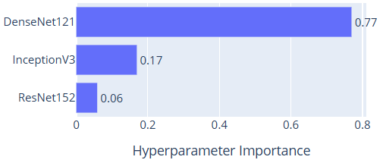
4. Experimental results
Fig 10b. Correlation and importance of parameters in Sce. 7.
Notes:
The colors of the lines represent the quality of each weight combination — darker lines correspond to higher objective values. The results show that the best objective values are often associated with high weights for DenseNet121, while InceptionV3 and ResNet152 often have lower weights.

Slide 22
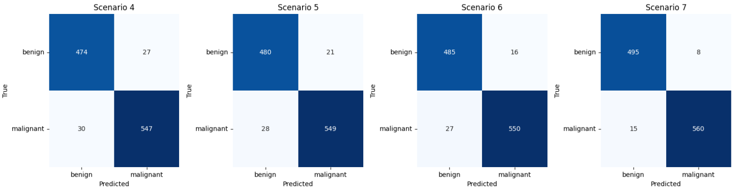
4. Experimental results
Fig 11. Confusion matrix of Sce. 4, 5, 6, 7

Slide 23
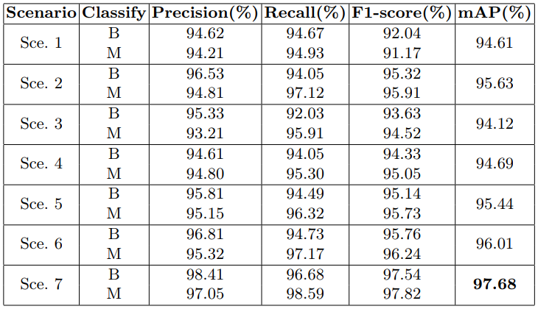
4. Experimental results
Tab 2. Evaluation results on test dataset
Notes:
The evaluation results of 3 scenarios indicate a generally good overall performance, with accuracy (Acc) ranging from 0.92 to 0.96. The U-Net model achieved the highest accuracy score (0.96) along with impressive metrics for Dice (0.93), IoU (0.91), and F1-Score (0.92). It also recorded very low RMSE and MSE values (0.017 and 0.0003), demonstrating its superior effectiveness in image segmentation. In contrast, U-Net++ and DeepLabV3+ exhibited slightly lower accuracy (0.92-0.93), with DeepLabV3+ achieving the lowest Loss value (0.2485) but a somewhat higher RMSE (0.026). Overall, U-Net stands out as the best model for this dataset, while DeepLabV3+ shows potential for improvement due to its low loss value.

Slide 24
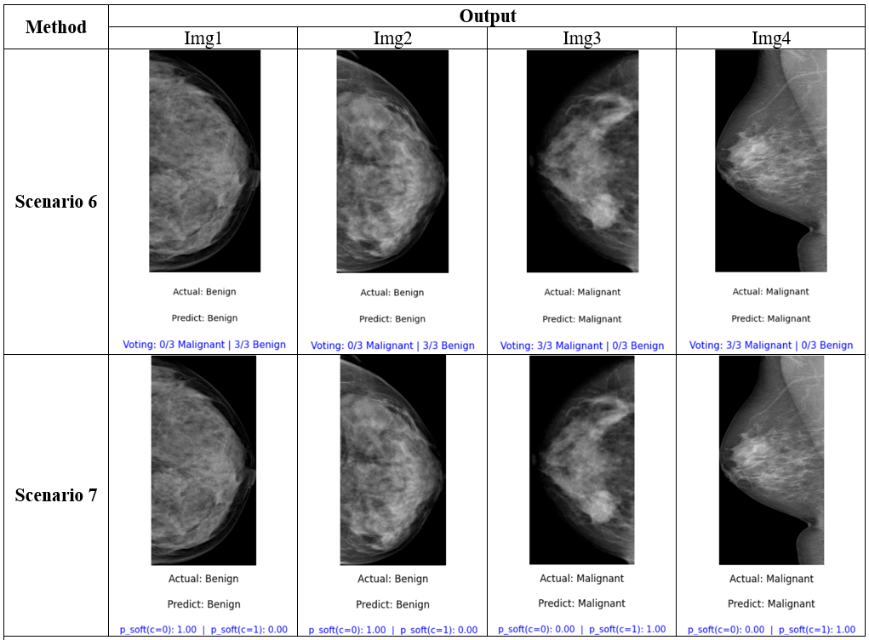
4. Experimental results
Fig 12. Prediction results on the test dataset of Sce. 6 and 7.
Notes:
The evaluation results of 3 scenarios indicate a generally good overall performance, with accuracy (Acc) ranging from 0.92 to 0.96. The U-Net model achieved the highest accuracy score (0.96) along with impressive metrics for Dice (0.93), IoU (0.91), and F1-Score (0.92). It also recorded very low RMSE and MSE values (0.017 and 0.0003), demonstrating its superior effectiveness in image segmentation. In contrast, U-Net++ and DeepLabV3+ exhibited slightly lower accuracy (0.92-0.93), with DeepLabV3+ achieving the lowest Loss value (0.2485) but a somewhat higher RMSE (0.026). Overall, U-Net stands out as the best model for this dataset, while DeepLabV3+ shows potential for improvement due to its low loss value.

Slide 25
5. Conclusion
We propose a comprehensive method for detecting and classifying breast cancer using deep learning ensemble models.
We propose RIDOPTNet, a deep learning ensemble framework that leverages the complementary strengths of multiple models to improve classification performance.
Optuna techniques to help the model automatically optimize the voting process in both hard and soft methods.
The proposed model improves classification on both classes compared to the baseline model and helps to increase the classification effciency on both classes, achieving 97.68% on the experimental dataset.

Slide 26
References
[1] W. H. Organization, WHO guidelines for screening and treatment of precancerous lesions for cervical cancer prevention. World Health Organization, 2021. Accessed: May 30, 2025. [Online]. Available: https://books.google.com/books?hl=en&lr=&id=eo5FEAAAQBAJ&oi=fnd&pg=PR3&dq=World+Health+Organization.+Preventing+Cancer.+2021&ots=w1Lq6GLTc-&sig=igSf5EdoHGhK2o10aPIj6-AbJNQ
[2] H. H. Pham, H. N. Trung, and H. Q. Nguyen, “Vindr-mammo: A large-scale benchmark dataset for computer-aided detection and diagnosis in full-field digital mammography,” Sci Data, 2022, Accessed: Jun. 09, 2025. [Online]. Available: https://www.physionet.org/content/vindr-mammo/1.0.0/.
[3] Y. Eroğlu, M. Yildirim, and A. Çinar, “Convolutional Neural Networks based classification of breast ultrasonography images by hybrid method with respect to benign, malignant, and normal using mRMR,” Computers in biology and medicine, vol. 133, p. 104407, 2021.
[4] A. P. Adedigba, S. A. Adeshina, and A. M. Aibinu, “Performance Evaluation of Deep Learning Models on Mammogram Classification Using Small Dataset. Bioengineering 2022, 9, 161.” s Note: MDPI stays neutral with regard to jurisdictional claims in published, 2022. Accessed: Jun. 10, 2025. [Online]. Available: https://www.academia.edu/download/91821754/pdf.pdf
[5] M. S. Hashim and A. A. Yassin, “Breast Cancer Prediction Using Soft Voting Classifier Based on Machine Learning Models.,” IAENG International Journal of Computer Science, vol. 50, no. 2, 2023

Slide 27

THANK YOU FOR
YOUR ATTENTION !!!

